Slide 1
California ELCC Analysis in SERVM
Astrape Consulting
6/2/2017
Notes:
1

Slide 2
Shifting Load Shape as More Renewable Are Added

Slide 3
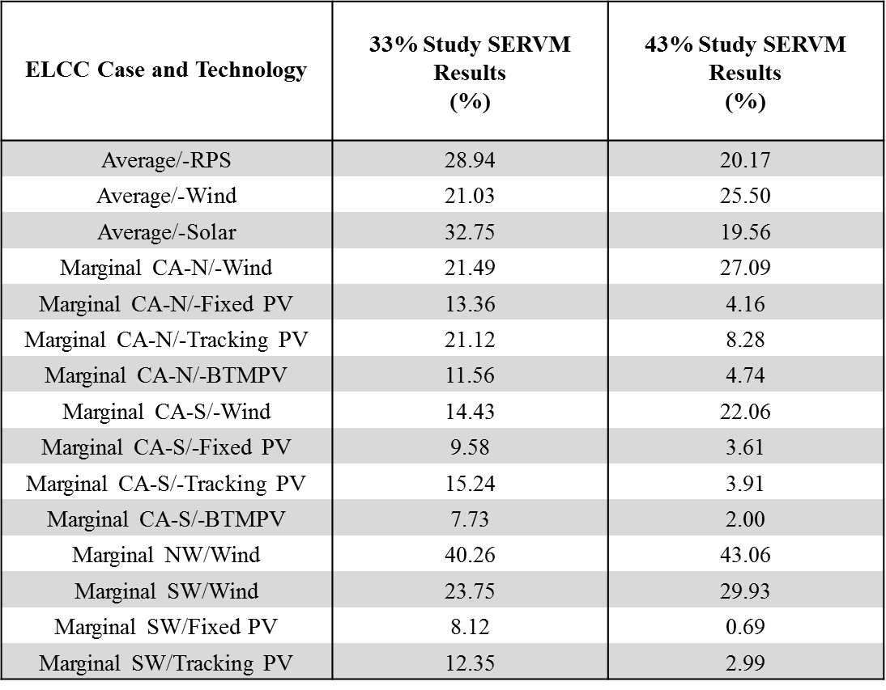
SERVM Results
Preliminary Draft Results

Slide 4
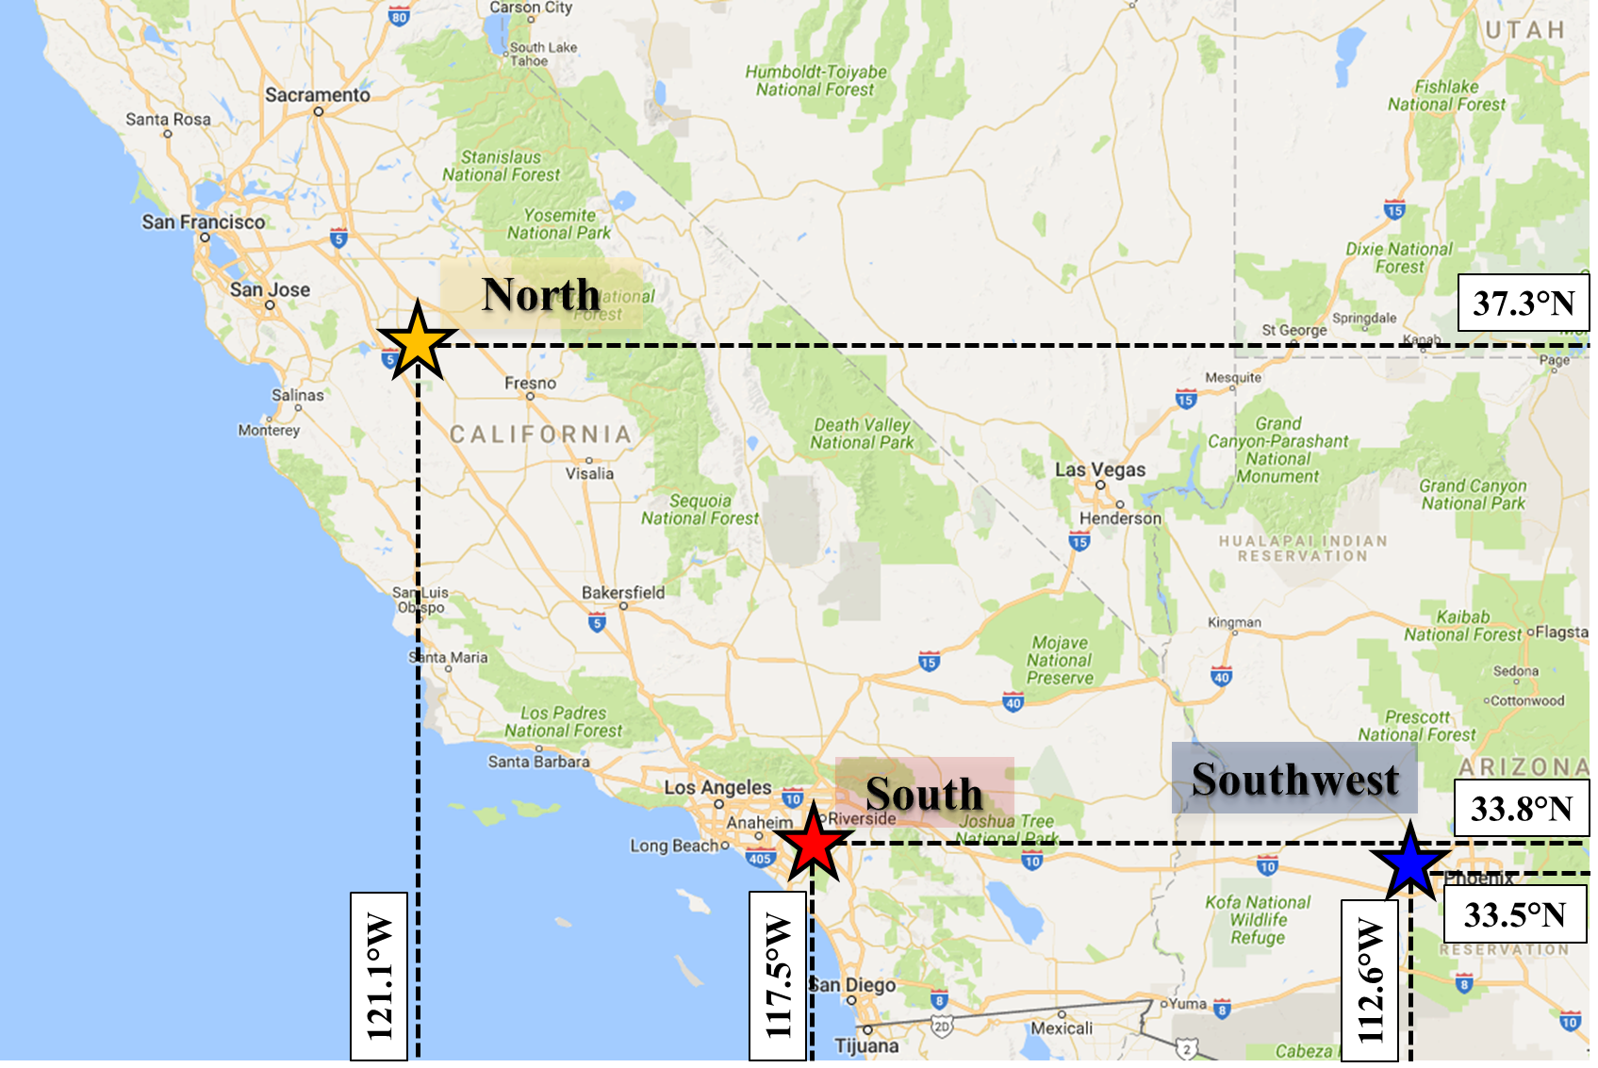
Weighted Average Location of Solar Locations Used for Each Region

Slide 5
Output as a Function of Longitude for Average August Hour 16

Slide 6
Output as a Function of Latitude for Average August Hour 16

Slide 7
33% Northern and Southern CA Average August Day Comparison

Slide 8
33% Southern CA and Southwest Average August Day Comparison

Slide 9
ELCC Approximation Method Illustration

Slide 10
Approximation Method Comparison to SERVM Results – 33% RPS Case

Slide 11
Approximation Method Comparison to SERVM Results – 43% RPS Case

Slide 12
RPS Example Dispatch – 33 and 43%

Slide 13
Instantaneous Load Compared to Hourly Integrated Load

